Slide 1
ANALYSIS AND DETECTION OF FAKE REPLICAS OF YOU TUBE CHANNEL Artificial intelligence and Expert system PROJECT (it-306)
Submitted To:
Ms. Reena Tripathi
Submitted By:
Mrityunjay Mishra (2K19/IT/080)
Naman Jain (2K19/IT/086)

Slide 2

INTRODUCTION
Nowadays YouTube has become one of the major source of information and Entertainment for its users ,its user base has been increasing exponentially and provides a platform for the content creators to showcase their Talent , so when a channel becomes successful and it is not verified, then people tend to create fake replicas of original channels and users/subscribers gets confused which is the Legit and which is Fake and it also causes a loss to the original content creator
So we are basically trying to create an K-CLUSTERING Unsupervised Model which can classify the channels into legit and fake , for this we are using multiple independent parameters like View Count, Likes, Subscribers , Date of Registration and Video Count, we got all the Information from YouTube API
We have also created an Artificial Neural Network Model which can classify the channels into Legit and Fake ,using Supervised Learning and finally we have tried to compare the performance of two created models (K-Clustering and Artificial Neural Network)

Slide 3
Implementation Details (Neural Networks)
The First Task was to create the dataset , so we have used the YouTube Api as the You Tube Api gives us the access to the important features of the channel and then we have collected over 190 samples of Flying Beast Channel Manually and created the dataset into a csv file
We have created an Artificial Neural Network whose architecture is [5,4,1] there is 1 hidden layer which has 4 neurons ,1 output layer as we are classifying the input int wo Classes (Legit and Fake)
We have used Sigmoid function as the activation function for the neural network and Cross Entropy function as the cost function and Gradient Descent as the optimization algorithm
We have implemented the backpropagation method and feed forward method from the scratch and has preprocessed the data using Standard Scaler Method
We have used Leave One out cross validation method for dividing the dataset into training and testing part with k=1 since our dataset is pretty small so we could afford to do it
Finally we trained our model for different epochs e.g. (100 150 170) and calculated Accuracy, Precision, F measure, Sensitivity, Specificity of our model.

Slide 4
Implementation Details (K Means Clustering)
Firstly we converted the csv data to the NumPy array to process it further.
Then we manipulated the data using mean imputation and normalization methods to have the resulting values between 0 and 1.
Now we applied K – means clustering algorithm with k = 2.
Choose the two random points on the graph of the dataset.
Check the distance of each data point from the two random points and label them as "0" or "1" by checking the shorter distance.
Find the centroid of all the data points labeled as "0" and move the 1st random point to that location.
Similarly, move the other random point to the centroid of "1" labelled data points.
Repeat the steps until the 2 points get fixed.
The resulting labels on the data points divides the data into 2 clusters.
Then we checked the calculated output with the actual output and measured the accuracy.

Slide 5
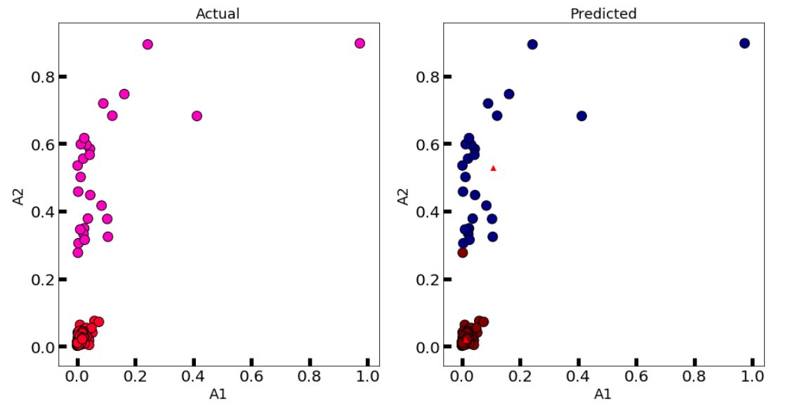
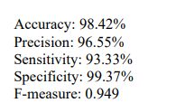

Results and Observation
After Training our model the results given by the Artificial Neural Network and K clustering Model are
From the given below results we can clearly say that both the models have performed really well the accuracy precision and F measure of Artificial neural network are really great an K clustering has also classified the channels with great accuracy.
Neural Network
K-CLUSTERING

